Slide 1

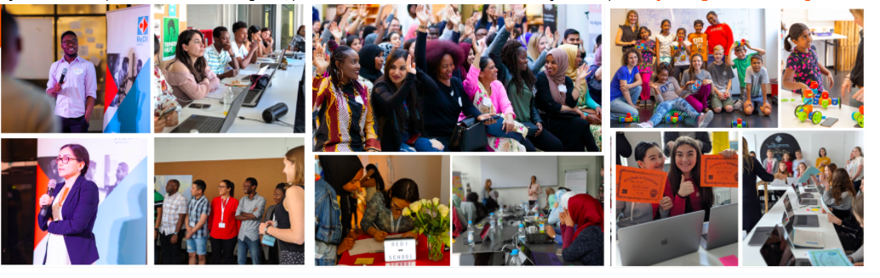

ReDI School Munich offers
A new Mentorship program for students in DCP and DWP

Slide 2

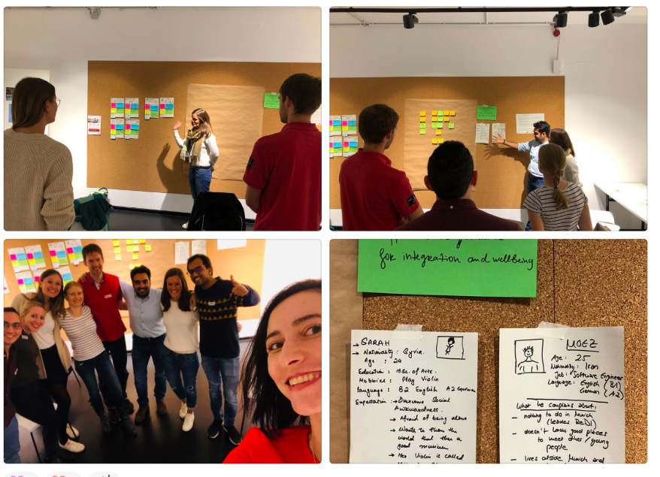
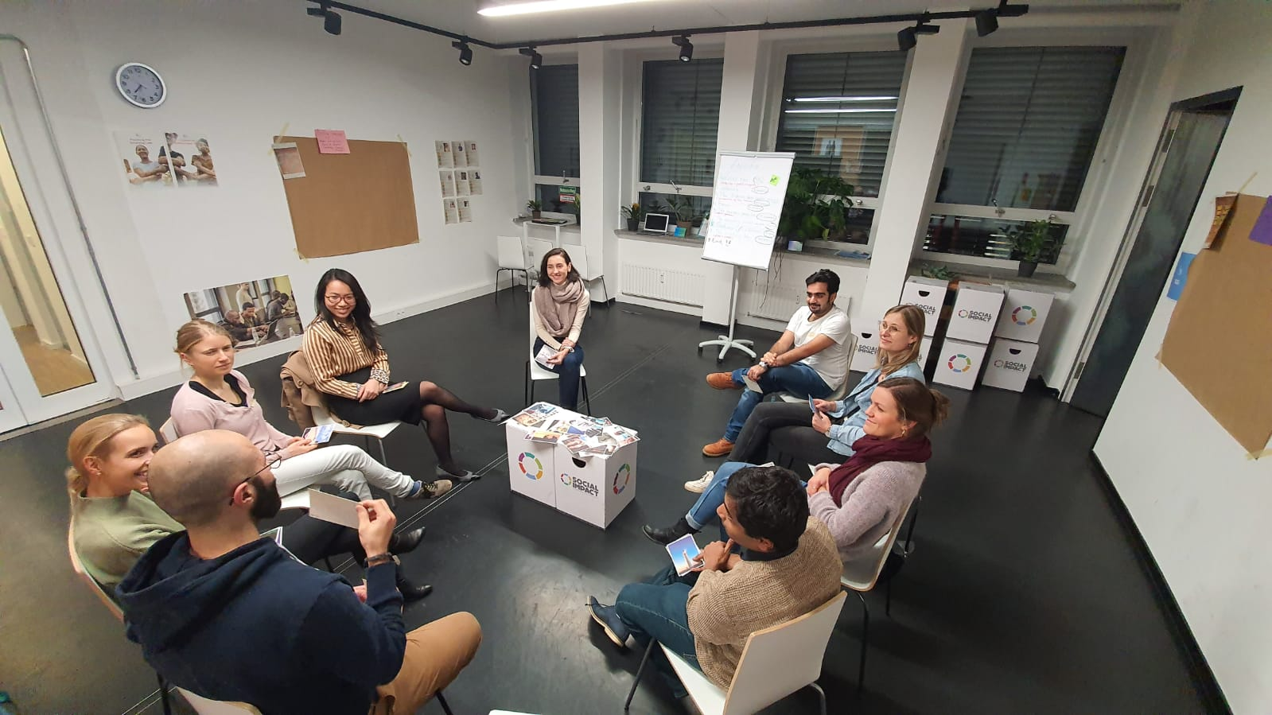
ReDI’s Mentorship Program offers:
Support and guidance through your IT learning journey
Support and guidance for soft skills developments
Support and guidance for career planning, job search and professional network building
Support and guidance for your personal growth, wellbeing and integration

Slide 3
Some important facts for interested students:
The Mentorship program offers 1:1 mentoring experience. So you and your mentor create individual plan for you
The Mentorship program starts with a Matching event on 3.12.19 ( 7pm-9pm) at Social Impact Lab and finishes in March ( 30.03.20)
After the Matching event only 11 students( DCP+ DWP) will be selected to participate in the program and work with mentors
The Mentorship is an amazing opportunity and also a serious commitment. The mentors and the mentees meet twice a month for a 60-90 minutes and often mentee receive some tasks from their mentors.
The group of mentors is really diverse: ladies and gentlemen mentors, mentors with programing skills, mentors capable to support soft skills building and career planning, mentors with experience in IT companies and other fields, mentors speaking English, German, French, Spanish and other languages, mentors ready to listen, help and guide you.
But they are only 11 !!!

Slide 4
Are you interested? If yes, then:
THE NEXT STEPS:
Please fill in the registration form that teachers will provide you till 26.11 Tuesday 11:59 pm
On 28.11 ( Thursday) you will receive feedback for your application and if you are approved on the first stage, then:
You will be invited to participate in The Matching event( 3.12) and to meet all 11 mentors.
On 2.12 ( Monday) you will receive information for all mentors and a short document that will help you to prepare for the Matching day ( 3.12)
On the Matching day, you meet all mentors and speak with them 1:1. Then you can decide which you prefer and apply for them :).
On 05.12 ( Thursday) 11 of the participants in the Matching day will be selected for mentees and connected with their mentors.
Unfortunately only 11 students will be selected for the mentorship after the Matching day, the others should wait for the next semester

Slide 5
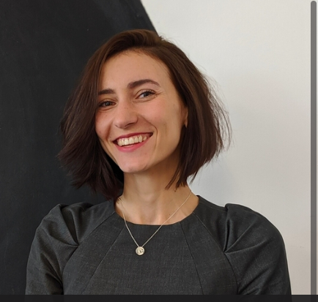
Thank you for your interest!
If you have any questions, please contact Yoana via Slack

